Slide 1
Augmenting Base LLMs

Slide 2
Augmenting LLMs
There are a number of ways to augment LLMs.
We focus on three different methods:
Finetuning
Prompting
Knowledge endowment
Notes:
So far, we have mainly talked about pretraining. This pretraining produces what we call the base or foundation model. These models, in particular generative models, are not always useful. At this point, they are simply very expensive sentence completion algorithms. Although, some of the larger models will still be able to do question answering or follow instructions, it helps to first finetune the model for this specific task.
Once the model is finetuned, there are some optimal ways that you might be able to elicit the best information out of chat models. In modern times, this has been given the name prompt engineering.
Finally, we can also endow the model with access to external knowledge bases or tools.

Slide 3
Finetuning base model
General LARGE training data
Small
training data
BASE LLM
Finetuned LLM
Notes:
We start with a general outline of the finetuning process.
We first train the base model with a massive amount of data to obtain the base LLM. In order to finetune the model for a specific task, such as chat or instruction following, we get a smaller dataset, and just apply the same process! It is really that simple!
There are some caveats here:
- When training a model, you make the assumption that the training data is roughly independent and identically distributed. For example, if you were training a model on multiple languages, you want to avoid first training the model with all of the English examples, then all of the French examples, etc. Because by the time you get to the end of your training data, the model has forgotten the first lot of examples!
- The base model has been conditioned on a massive amount of text, but we don’t want to alter the weights of the model too much, because then we might “forget” some of the original information that we learnt (a phenomenon called catastrophic forgetting).
- Typically, the finetuning dataset is usually significantly smaller than the pretraining dataset, and finetuning is therefore a much cheaper process. It is never intended to override any of the model’s base knowledge, it is rather meant to “guide” the model to exhibit a particular behavior or style.
What are some ways we can finetune some models then?

Slide 4

Domain-Specific Finetuning of a Base Model
E.g. finetuning on Parliament sessions
https://hansard.parliament.uk/
May be done using a method like LoRA
Notes:
One thing that we can do is finetune on domain-specific data. For example, we might want to finetune a model on parliamentary sessions, so that the model will have some knowledge of parliamentary proceedings, or to talk in the style of someone presenting in parliament.
It is very expensive to train all the weights in a model, so typically some are either frozen, or advanced techniques such as Low Rank Adaptation is used

Slide 5
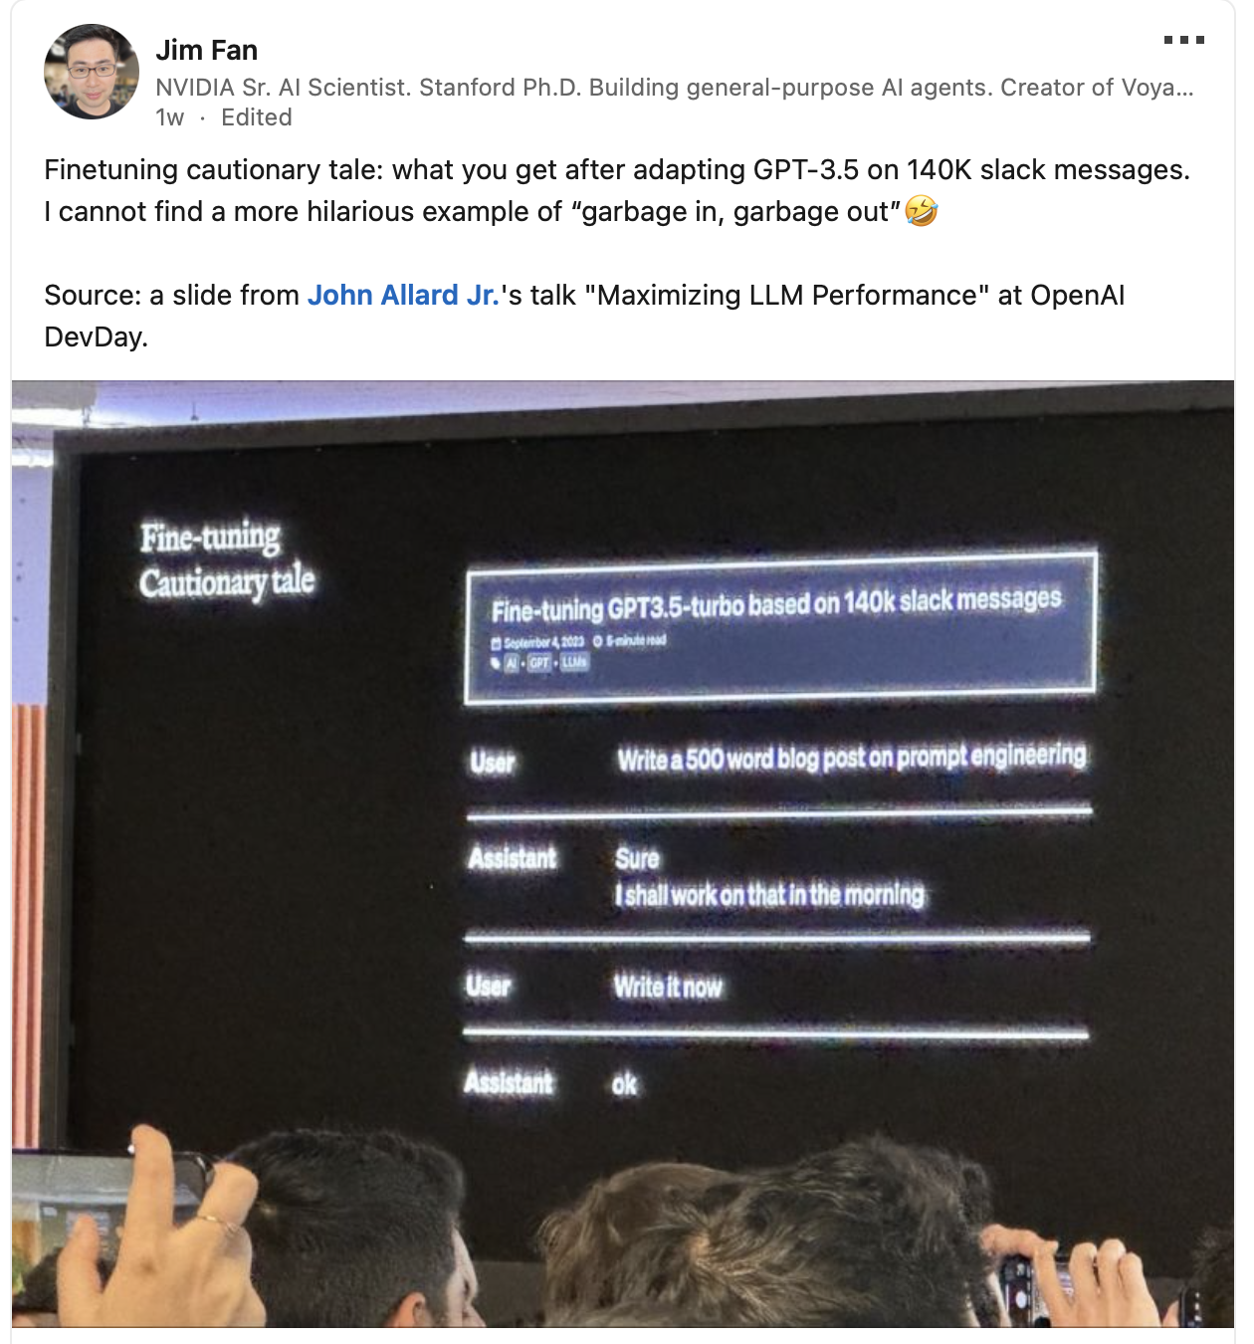
A Cautionary Tale
Pitfalls of LLMs include:
Bias
Hallucination
Static/fixed in time
Notes:
We have to be careful though! Here is an example of GPT-3.5-turbo trained on slack messages.

Slide 6
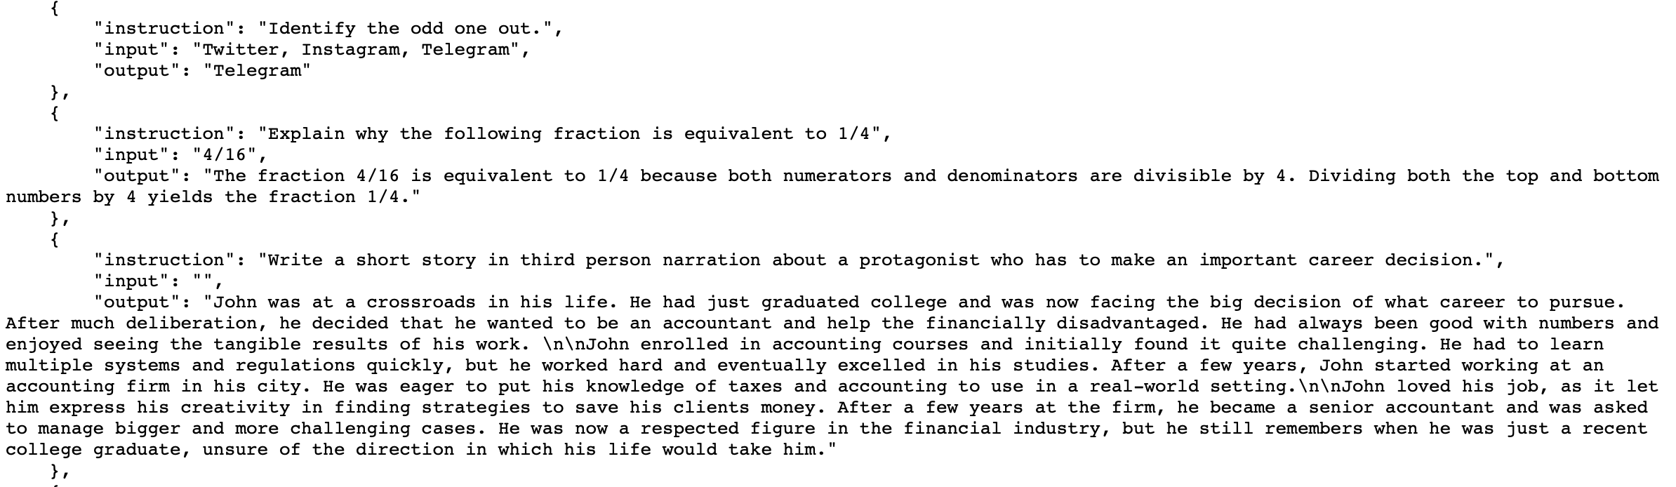
Instruction Tuning (IT)
See e.g. Stanford's Alpaca data
https://github.com/tatsu-lab/stanford_alpaca
Notes:
We might want to endow the model with a chat-like behavior, or to be able to follow instructions in the form of:
“Do X for me.”
The Alpaca dataset is a large instruction-tuning dataset, where the model is present with text of the following form.
This data is then fed into the model in the same way as you would feed in the pretraining data, and the model learns this conversational, instructional style. For example when you type into the text box on an LLM, the model will be fed the following prompt.
Your input to the text box: “Tell me a story about a duck.”
The model will receive as input:
{
“Instruction: tell me a story about a duck.
Output: “
}
The model is still doing text completion, but it has learned the style of question answering.

Slide 7
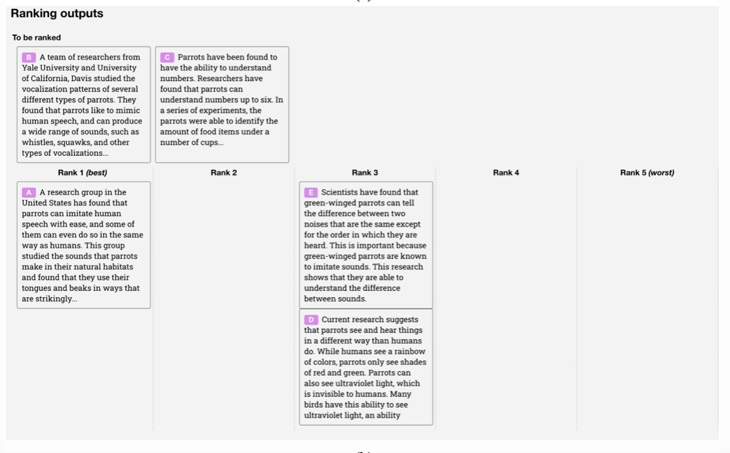
Reinforcement Learning from Human Feedback (RLHF)
Notes:
It is often easier for a human to compare answers than for a human to write an exemplar answer.
We, as humans, can compare answers and rank the answers, and then we can further finetune the model using these high quality question response pairs

Slide 8
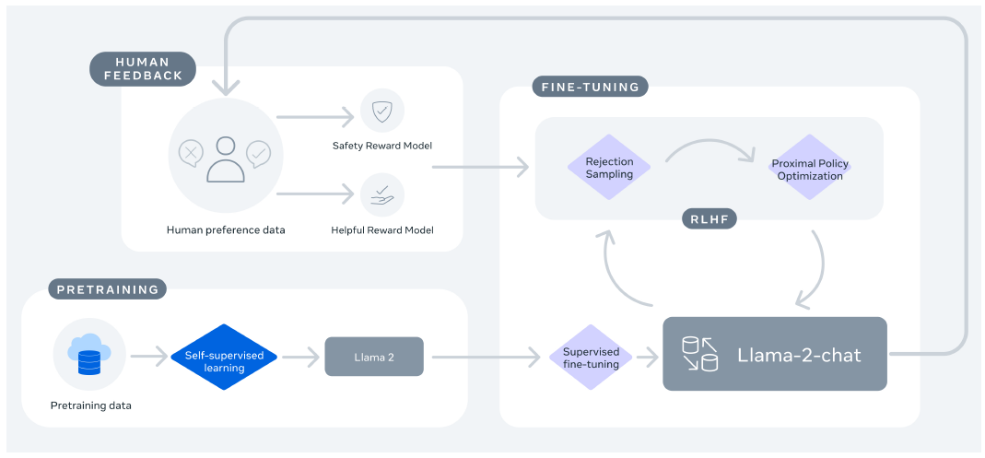
Reinforcement Learning from Human Feedback (RLHF)
Notes:
The rough outline is as follows:
Pretrain the model and then finetune on a high quality chat or instruction tuning dataset.
We can then chose to have the model generate a few responses to a given prompt, and human annotators rank responses.
This feedback is used to train a reward model. The job of the reward model is to predict the quality of the model’s responses based on human preferences.
The LLM is then further trained to maximize the predicted reward.
The whole point of RLHF is to align the model to human preferences, and it is highly effective.

Slide 9
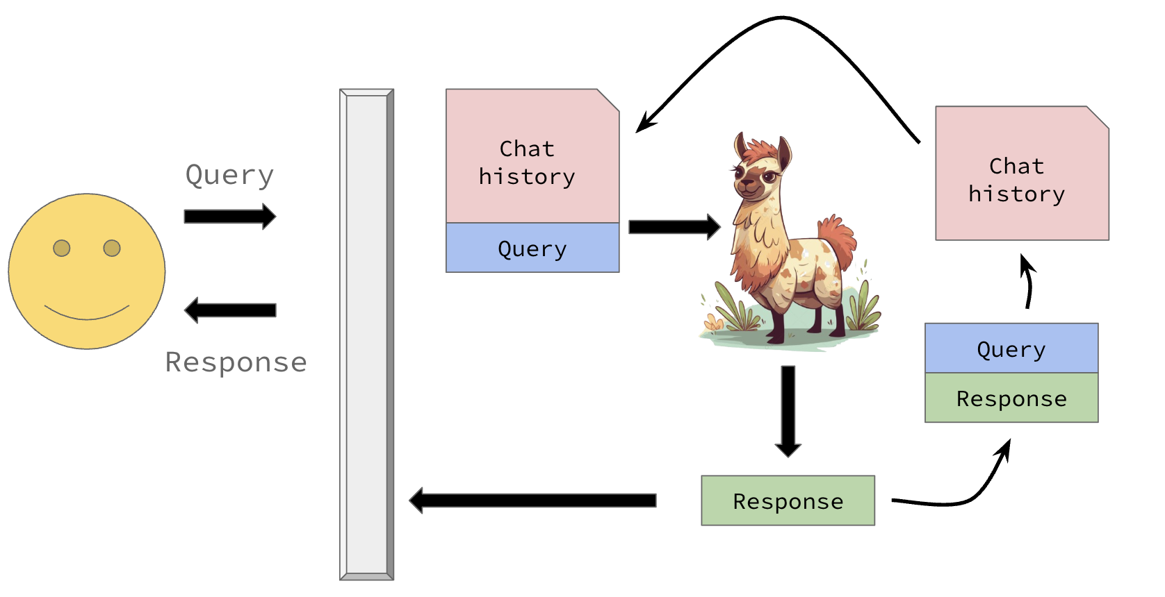
LLMs are stateless…
We have to add stuff to give them knowledge

Slide 10
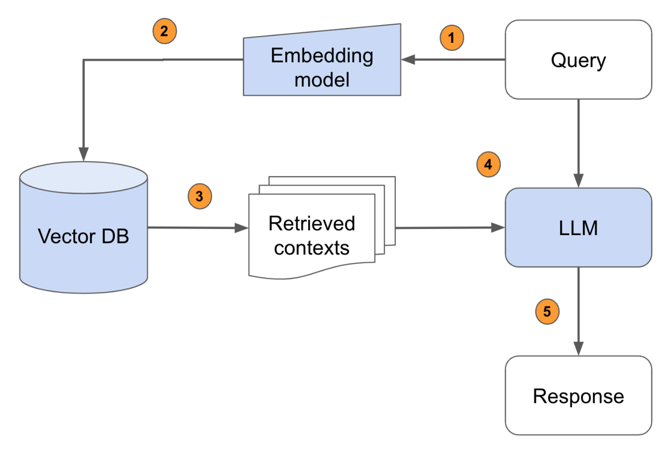
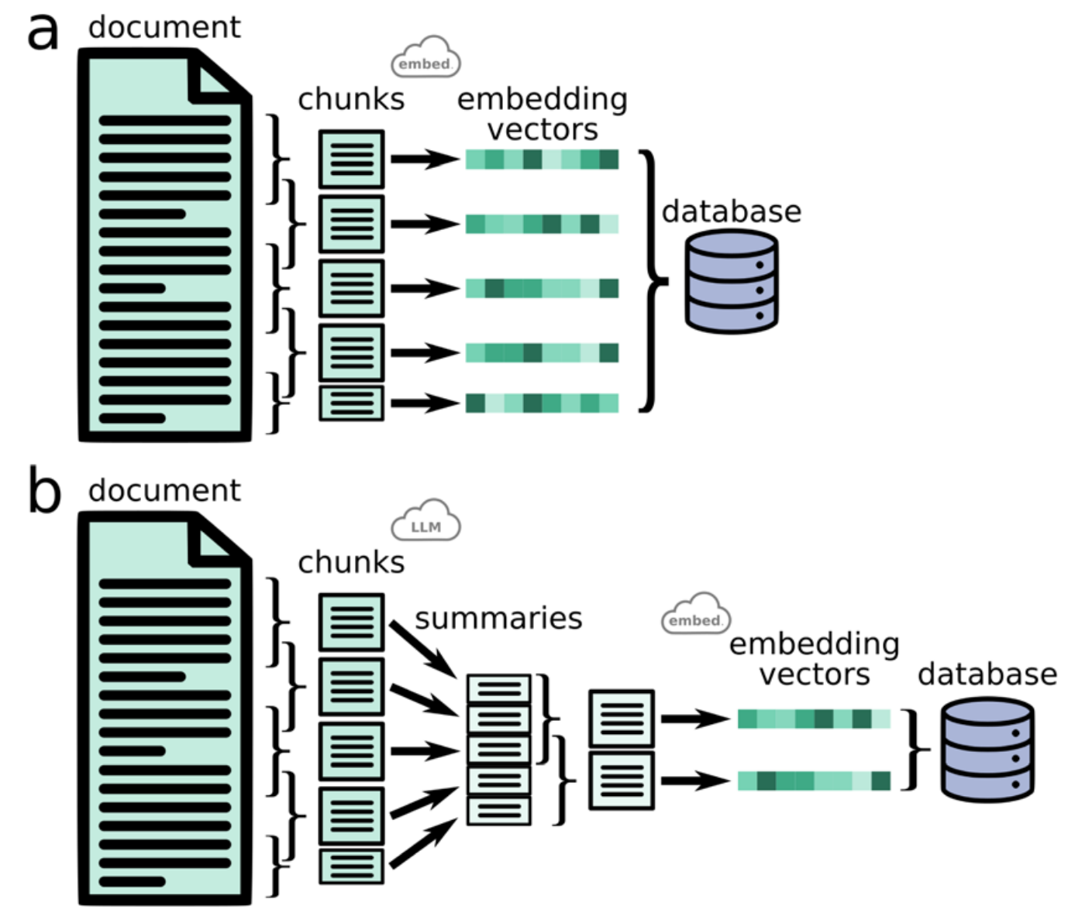
Retrieval Augmented Generation (RAG)
Notes:
Retrieval Augmented Generation is a simple idea:
Suppose you want to endow an LLM with knowledge, for example from a text book.
You first break the textbook down into manageable chunks and embed them into a high dimensional space and store the chunks in a database.
You then send a query to the LLM. The embedder embeds your query and looks for semantically similar chunks of text in your database.
Fetch the top N chunks and prepend them onto the query.
Send the query to the LLM.
That’s it…
As context size increases, I can’t see how RAG is useful, since you can upload an entire textbook as context. However for smaller models, this may be quite a good approach.

Slide 11
Augmenting LLMs
A base model is a model which has been pretrained on a massive amount of text for next token generation.
In order to give a model a specific style or domain knowledge, we can do further training on domain specific data.
In order to elicit chat-like behaviour, we can use an instruction or chat dataset like Alpaca.
To further align LLMs to our needs we can incorporate human feedback.
We can also endow the LLM with knowledge by using a database of contextual information.
There are specific prompting strategies to get the best performance out of chat models.
Notes:
Summary

Slide 12
Resources
LoRA
Instruction Tuning
RLHF
https://www.youtube.com/watch?v=dbo3kNKPaUA (Video in 3 sections – sections 1 (0:00-7:30) and 3 (27:52-49:00) are most accessible)​
RAG intuitively and exhaustively explained
Prompt Engineering
Notes:
.

Slide 13
LUNCH

